Slide 1
STUDENT NAME :SHARMILA R
PROJECT TITLE :SPEECH RECGONITION USING RNN MODEL
3/21/2024 Annual Review

Slide 2
PROJECT TITLE
SPEECH RECGONITION USING-RNN MODEL(Recurrent Neural Network)
-
3/21/2024 Annual Review

Slide 3


AGENDA
Problem statement
Project overview
Who are the end users
Your solution and its value proposition
The wow in your solution
Modelling
results
3/21/2024 Annual Review

Slide 4

PROBLEM STATEMENT
Data Preprocessing:
Tokenization: Convert words into numerical tokens.
Padding: Ensure uniform length of input sequences.
Splitting: Divide the dataset into training and testing sets.
Model Architecture:
Input Layer: Convert tokenized words into dense word embeddings.
Recurrent Layers: Utilize LSTM or GRU layers to capture sequential dependencies in the text.
Output Layer: Apply a sigmoid activation function to predict the sentiment (positive or negative).
Training and Evaluation:
Compile the model with appropriate loss function and optimizer.
Train the model on the training set and validate on the testing set.
Evaluate model performance using metrics such as accuracy, precision, recall, and F1-score.
3/21/2024 Annual Review

Slide 5

PROJECT OVERVIEW
Understanding RNNs
Dataset Selection and Preprocessing
Model Development
Training and Evaluation
Text Generation and Sampling
Analysis and Interpretation
Visualization and Reporting
3/21/2024 Annual Review

Slide 6

WHO ARE THE END USERS?
Consumers of Generated Text
Decision Makers and Stakeholders
Researchers and Data Scientists
Software Developers and Engineers
End Users in Specific Domains
General Public
3/21/2024 Annual Review

Slide 7

YOUR SOLUTION AND ITS VALUE PROPOSITION
Text Generation Capabilities
Creativity and Versatility
Quality and Coherence
Personalization and Adaptability
Efficiency and Scalability
Insights and Analysis
3/21/2024 Annual Review

Slide 8

THE WOW IN YOUR SOLUTION
Creativity and Novelty
Naturalness and Coherence
Adaptability and Customization
Real-time Generation
Insights and Analysis
Human-like Interaction
3/21/2024 Annual Review
8

Slide 9
MODELLING
Define the Problem
Data Preparation
Choose the RNN Architecture
Design the Model Architecture
Compile the Model
Train the Model
Evaluate the Model
3/21/2024 Annual Review
9

Slide 10
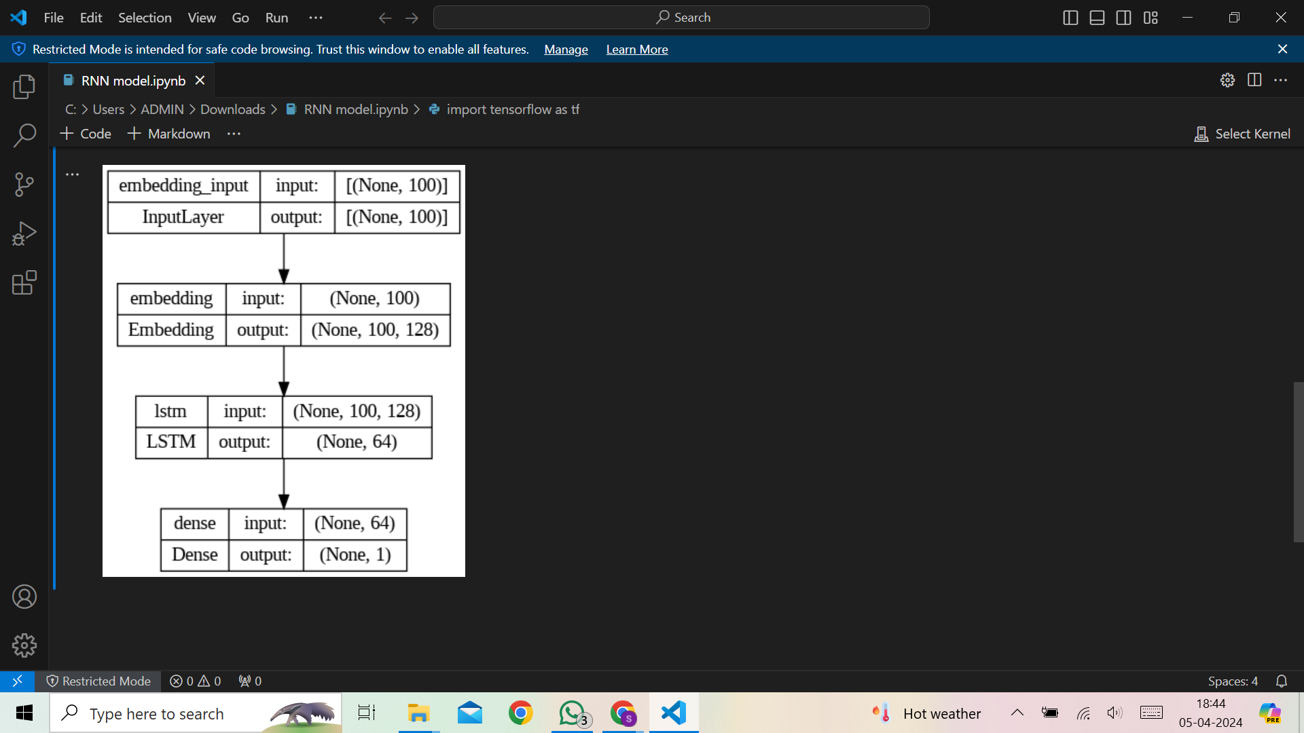
RESULTS
3/21/2024 Annual Review
10

